Slide 1

INTERNET PROGRAMMING AND MOBILE PROGRAMMING
DR NKEMENI VALERY

Slide 2
DATABASE DESIGN
SYSTEM ANALYSIS
DATABASE NORMALIZATION
SELECTING A DBMS

Slide 3
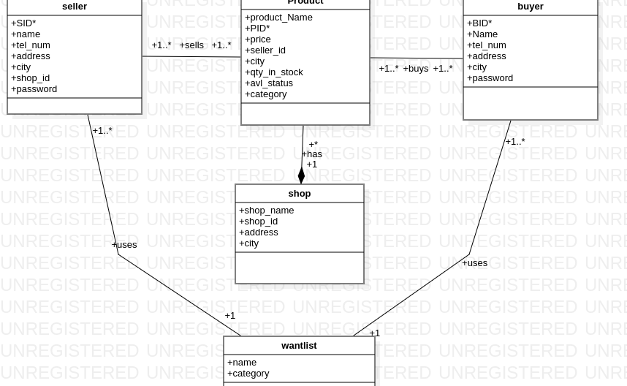
CLASS DIAGRAM FOR DATABASE

Slide 4
PRODUCT TABLE
PID(int)(primary key)
PRODUCT_NAME(name)
PRICE(int)
SELLER_ID(int)
QTY_IN_STOCK(int)
CITY(text)
AVL_STATUS(Boolean)
CATEGORY(name)

Slide 5
SELLER TABLE
SID(int)(primary key)
NAME(name)
TEL-NUM(big int)
ADDRESS(text)
CITY(name)
SHOP_ID(int)
PASSWORD(text)

Slide 6
BUYER TABLE
BID(int)(primary key)
NAME(name)
TEL_NUM(big int)
ADDRESS (text)
CITY(name)
PASSWORD(text)

Slide 7
Shop table
SHOP_NAME(name)
SHOP_ID(int)(primary key)
ADDRESS (text)
CITY(name)

Slide 8
WANTLIST TABLE
WNAME(name)(PK)
CATEGORY(text)

Slide 9
Data base normalization.
FIRST NORMAL FORM
SECOND NORMAL FORM
THIRD NORMAL FORM

Slide 10
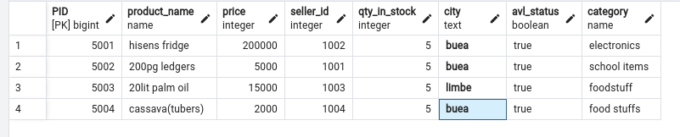
PRODUCT TABLE

Slide 11
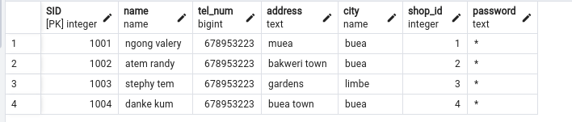
SELLER TABLE

Slide 12
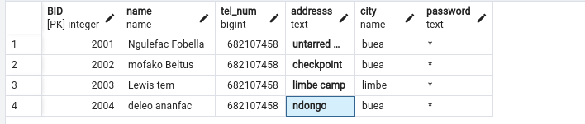
BUYER TABLE

Slide 13
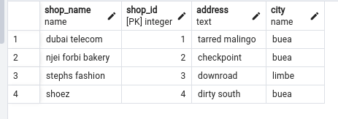
SHOP TABLE

Slide 14
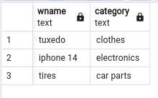
WANTLIST TABLE

Slide 15

ARIGATO GOZAIMUS

